Slide 1
3. (Linear) Lie Groups
Definition
The Connected Components
Compactness
Invariant Integration

Slide 2
3.1. Definition of a Linear Lie Group
Mathematical structures associated with a Lie group:
Algebraic: group axioms.
Topological.
Differential: analytic manifold.
General definitions:
Topological group with analytic properties
Analytic manifold with group properties
Basic features of a Lie group:
∃ a continuum of elements around E:
  Analytic manifold → Metric, Parametrization, …
Group structure determined by a real Lie algebra

Slide 3
Simplifying feature of a linear Lie group:
“Nearness” & “continuity” are that of a Euclidean space
A group G is a linear Lie group of dimension n if
A. G has at least one faithful finite-dimensional representation Γ, which defines a Euclidean metric on G.
Every element in a small enough neighborhood M_{δ} of E can be parametrized by n real parameters x = { x₁,…,x_{n} }, with no two x representing the same group element.
This defines a map M_{δ} → R^{n} with E  0.
Every point in a small enough neighborhood N_{η} around 0 in R^{n} can be mapped into a point in a set R_{η} ⊆ M_{δ}
  B & C imply map T: N_{η} → R_{η} is isomorphic
Every matrix element of Γ(x) ≡ Γ( T(x)), where T(x) ∈ R_{η}, is an analytic function of x. ( Taylor series exists )
Elaborate on A
Continue

Slide 4
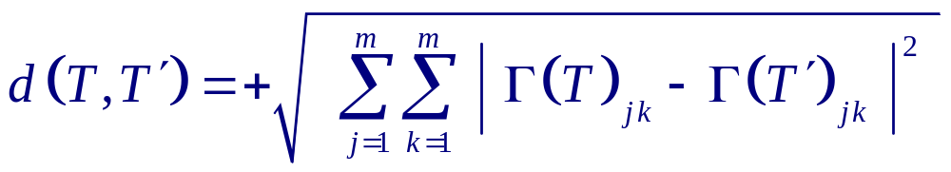

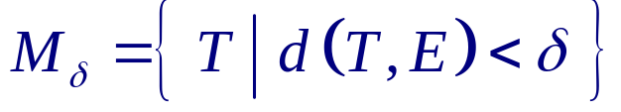
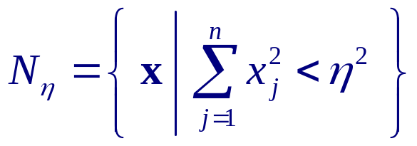
A. G has at least one faithful m-D representation Γ
Distance between elements T and T' of G is given by the distance function
which satisfies the metric axioms:
d(T',T) = d(T,T') ( symmetric )
d(T,T') ≥ 0 ( positive semi-definite )
d(T,T') = 0 iff T = T'
d(T,T') + d(T',T") ≥ d(T,T") (Triangular inequality)
Topology of group ~
Γ(T) ~ m²-D complex Eucliden vector
Neighborhood of E :
Neighborhood of 0 in R^{n}:
Back

Slide 5
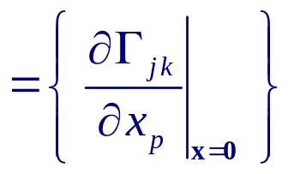
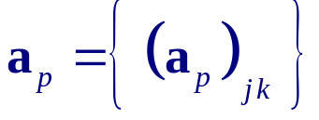


Let
Theorem I: { a_{p} } forms a basis for a n-D real vector space
Proof: see Cornwell, Chap 3, Sec 1.
Caution: a real vector space requires only that the scalars are real.
The vectors themselves can be complex.
Important: { a_{p} } forms a basis for a real Lie algebra [see Chap 8]
A single set of parametrization x can cover the connected subgroup. (see Section 2 )

Slide 6
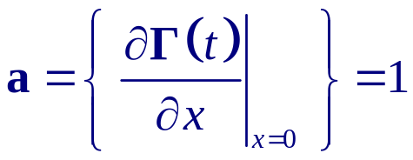
Example I: Multiplcative Group of 
G = {  , · } with · = arithmetic ×
E = 1
Faithful 1-D representation: Γ (t) = t ∀ t ∈ 
Metric: d(t,t') = | t - t'|
d(t,1) = | t – 1|
Parametrization for t ∈ M_{δ} : t(x) = e^{x}
E = t(0) = 1
Let δ= ½ : M_{½} = { t | | t – 1 | < ½ } = { ½ < t < 3/2 }
e^{x} = ½ → x = ln ½ = -ln 2, e^{x} = 3/2 → x = ln 3/2
Since ln 2 > ln 3/2, choose η = ln 3/2
→ R_{η} = { e^{x} | x² < η² } = { e^{x} | -ln 3/2 < x < ln 3/2 }
= { 2/3 < t < 3/2 }
is a basis for a 1-D vector space

Slide 7


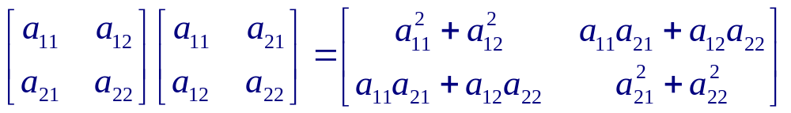
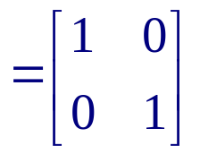
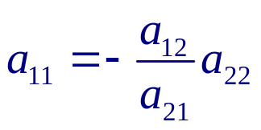
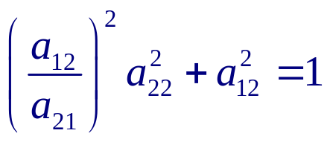
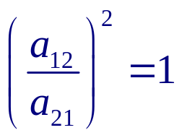

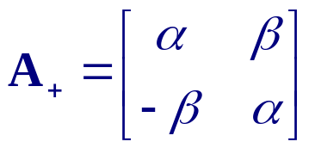
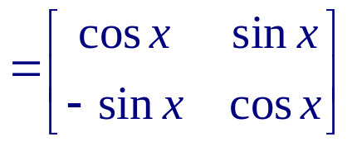




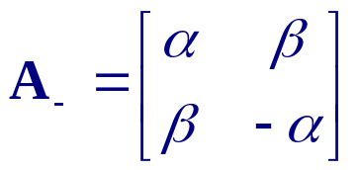
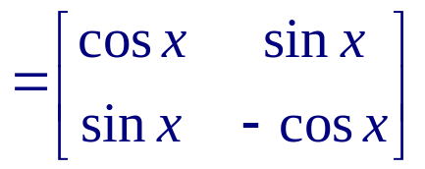


Example II: O(2) & SO(2)
O(2) = Group of all real orthogonal 2×2 matrices A
SO(2) = subgroup of O(2) with det A = +1
Orthogonality:
→
For A ∈ O(2):
→
→
→
For
→
→
→
SO(2)
For
→
→
→

Slide 8
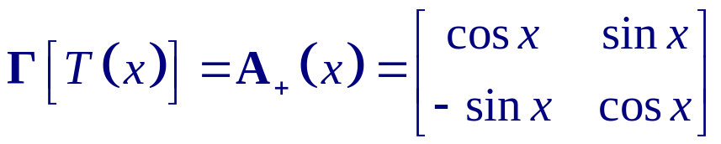
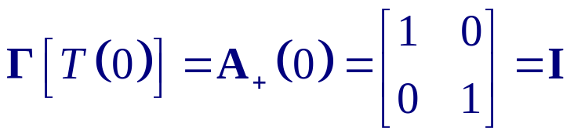
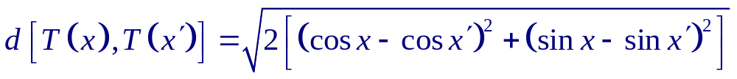
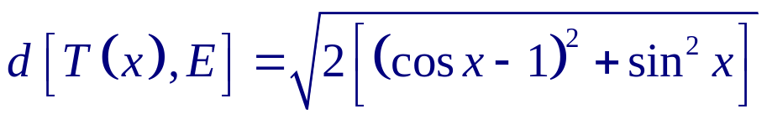
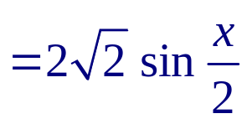

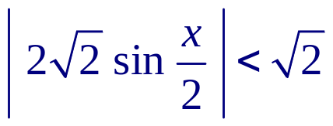
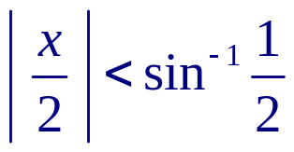
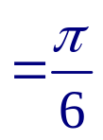
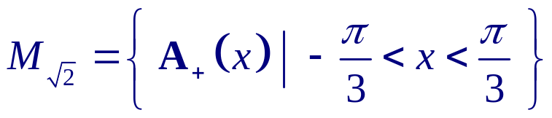
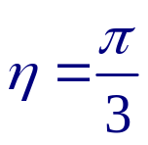

O(2): Lie group with faithful 2-D representation: Γ(T) = A
Parametrization near E:
Analytic
→ Dimension n of O(2) is 1
Identity E = T(0) :
Let δ = √2.
→
→

Slide 9

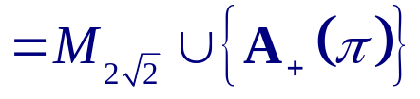
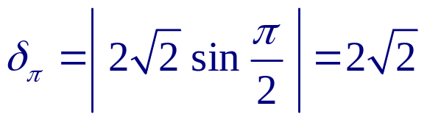
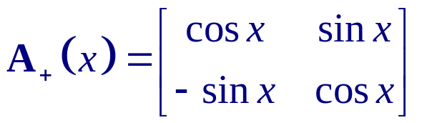
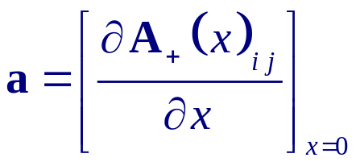
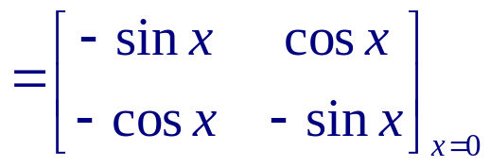
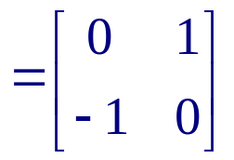
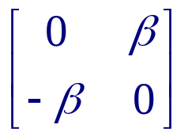
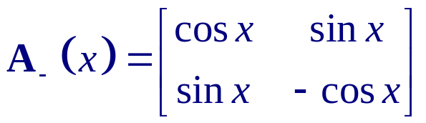
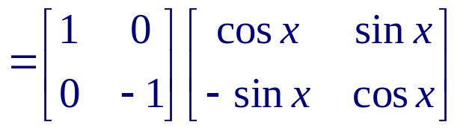
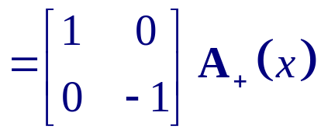
Note that
where
a is a basis of a 1-D vector space of elements

Slide 10

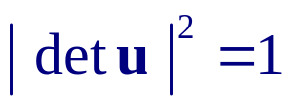
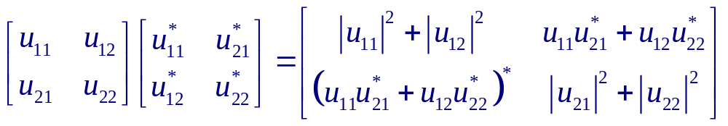
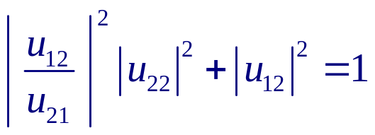
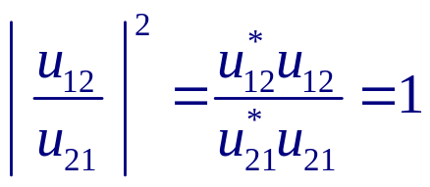
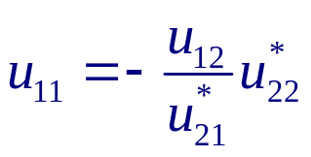
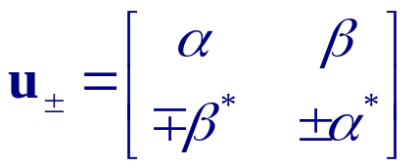


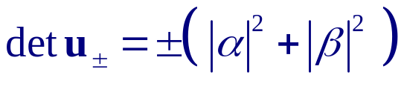
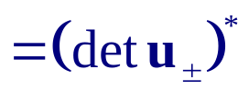
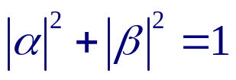

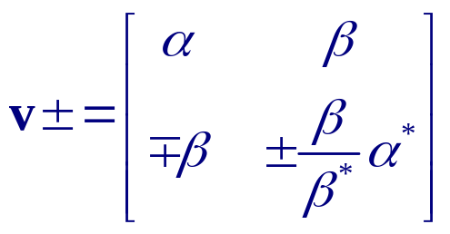
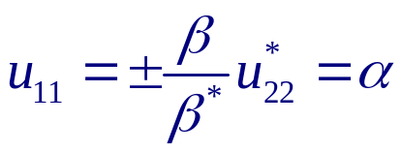

Example III: SU(2)
SU(2) = Group of all unitary 2×2 matrices u with det u = 1
Unitarity :
→
For u ∈ U(2):
→
→
→
For
with
For

Slide 11
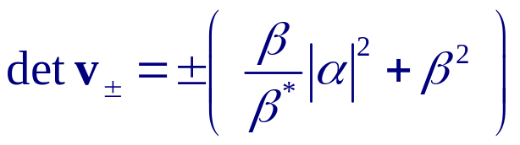
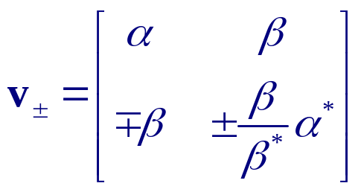
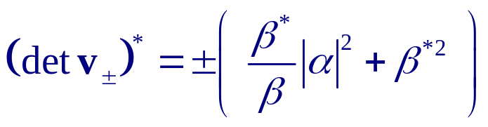

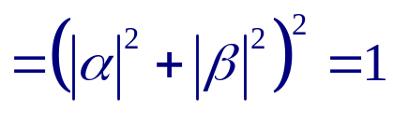


→
→
→
Elements of U(2): v± & u±
Elements of SU(2):
where

Slide 12











(Shortcoming of this scheme)
Parametrization near E:
(n = 3)
Vaild for
Reason for choice:
where σ_{j} are the Pauli matrices:

Slide 13













∴ { a_{j} } spans a 3-D vector space of traceless SU(2) matrices

Slide 14













→
→
Since w ≥0, inequality is always satisfied if δ > 2
For δ < 2, it becomes
→
Thus
∀ δ < 2 gives R_{η} = M_{δ}

Slide 15
Restriction of w ≥ 0 will be removed later
Analogous calculations give
  Dim[ O(N) ] = Dim[ SO(N) ] = ½ N(N-1)
  Dim[ U(N) ] = N²
  Dim[ SU(N) ] = N²-1
Definition: Lie Subgroup of a Linear Lie Group
A linear Lie subgroup of a linear Lie group is called a Lie subgroup

Slide 16
2. The Connected Components
Definition: Connected components of a linear Lie group G
≡ Connected sub-manifolds of G.
≡ Maximal set of T ∈ G obtainable from continuous variation of x, starting from some x₀, in the faithful representation Γ[T(x)] of G.
Example I: G = {  \{0}, ×}
{ t > 0 } is the connected component obtainable from any t₀ > 0.
It is a subgroup since it contains E = 1.
{ t < 0 } is the connected component obtainable from any t₀ < 0
Example II: O(2) & SO(2)
SO(2) is the connected component of O(2) containing E = I
{ A ∈ O(2) | det A = -1 } is another connected component

Slide 17
Theorem I: Connected Subgroup C of Linear Lie Group G
Connected component C containing E is an invariant subgroup of G.
C ≡ connected subgroup of G
Every connected component of G is a right coset of C
Proof: Skipped ( see Cornwell )
In principle, G may have an infinite number of connected components
Definition: Connected Linear Lie Group
A linear Lie group is connected if it has only one connected component
Implications:
Entire connected linear Lie group can be described by parameters y such that Γ[T(y)] is continuous
Γ[T(y)] need not be analytic → y not equivalent to x

Slide 18










Example III: SU(2)
with
→
Another choice is
α & β will range over the entire complex plane if
→
parametrizes continuously the entire SU(2)
However, parametrization is not 1-1 near E, e.g.,
Consequently
is not a basis

Slide 19
Other connected linear Lie groups:
SO(N) & SU(N) for N ≥ 2
U(N) for N ≥ 1
Paramtrizations for connected linear Lie groups:
x → Lie algebra ~ group structure around E ( Chap 8)
x' → global features ( Below )

Slide 20
3. Compactness
Reason of introducing compactness:
Boundedness not preserved by homeomorphism, e.g., (0,1) ~ 
Compactness is
For metric spaces, Compact = Closed + Bounded
Definition: Compactness
A topological space is compact if every open covering has a finite sub-covering
Theorem I: Heine-Borel Theorem
A subset S of ^{n} is compact iff S is closed & bounded
If { x' } of a connected linear Lie group G is a compact set of ^{n}, then G is compact
G is bounded if ∃ M > 0 ∋ d(T,E) < M ∀ T ∈ G

Slide 21
Characterization: Compact Linear Lie Group of Dimension n
A linear Lie group of dimension n with a finite number of connected components is compact if x_{j}' ∈ [a_{j},b_{j}] ∀ j = 1,…,n
Nice properties of compact Lie groups:
Every Lie subgroup of a compact Lie group is compact
Caution: non-compact Lie group can have compact Lie subgroups
Representation theory of compact Lie groups are similar to that of finite groups
Compactness for a semi-simple Lie group can be determined through its Lie algebra

Slide 22
Example I: G = {  \{0}, ×} ( non-compact )
Faithful representation: { Γ(t) = t ∈  \{0} } is unbounded
Example II: O(N) & SO(N) ( compact )
O(2) & SO(2), with x' = x ∈ [-π,π], are compact
Likewise for O(N) & SO(N)
Example III: U(N) & SU(N) ( compact )
U(2) & SU(2), with x'∈[0,π/2] & y',z'∈ [0,2π], are compact
Likewise for U(N) & SU(N)

Slide 23





4. Invariant Integration
Definition: Complex valued function f on G
f: G →  T  f(T)
e.g., Γ(T)_{jk}
Finite groups: Sum over group elements:
Rearrangement theorem implies, ∀ T'∈ G ,
Sum is left-invariant
Sum is right-invariant
E.g., f(T) = 1 ∀ T →
Connected Linear Lie groups:
Issues:
Left & right invariance
Convergence
ρ = density

Slide 24






Haar's measure theory: For a large class of topological groups, ∃
left invariant
right invariant
I.e.,
The weight functions σ are unique up to a constant factor
G is unimodular if
For G with multiple connected components C_{j},

Slide 25




Theorem I: Peter-Weyl
G compact → G unimodular and
exists for all f continuous.
Thus, one can always set
Theorem II:
If G is non-compact, both
diverge
Theorem III:
If G is Abelian or semi-simple, G is unimodular
Note: explicit form of σ is seldom needed

